Slide 1

UNIVERSITY INSTITUTE OF ENGINEERING
COMPUTER SCIENCE ENGINEERING
Machine Learning
23CSH-651
By
Dr. Meena Pundir
INTRODUCTION
DISCOVER . LEARN . EMPOWER

Slide 2
Reinforcement Learning

Slide 3
What is learning?
Learning takes place as a result of interaction between an agent and the world, the idea behind learning is that
Percepts received by an agent should be used not only for acting, but also for improving the agent’s ability to behave optimally in the future to achieve the goal.

Slide 4
Learning types
Learning types
Supervised learning:
a situation in which sample (input, output) pairs of the function to be learned can be perceived or are given
You can think it as if there is a kind teacher
Reinforcement learning:
in the case of the agent acts on its environment, it receives some evaluation of its action (reinforcement), but is not told of which action is the correct one to achieve its goal

Slide 5
Reinforcement learning
Task
Learn how to behave successfully to achieve a goal while interacting with an external environment
Learn via experiences!
Examples
Game playing: player knows whether it win or lose, but not know how to move at each step
Control: a traffic system can measure the delay of cars, but not know how to decrease it.

Slide 6
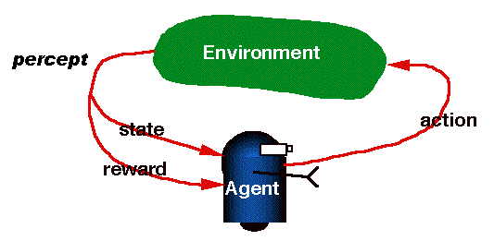
RL is learning from interaction

Slide 7
RL model
Each percept(e) is enough to determine the State(the state is accessible)
The agent can decompose the Reward component from a percept.
The agent task: to find a optimal policy, mapping states to actions, that maximize long-run measure of the reinforcement
Think of reinforcement as reward
Can be modeled as MDP model!

Slide 8
Review of MDP model
MDP model <S,T,A,R>
S– set of states
A– set of actions
T(s,a,s’) = P(s’|s,a)– the probability of transition from s to s’ given action a
R(s,a)– the expected reward for taking action a in state s
Agent
State
Action
Reward
Environment
a₀
a1
a2
s₀
s₁
s2
s3
r₀
r1
r2

Slide 9
Model based v.s.Model free approaches
But, we don’t know anything about the environment model—the transition function T(s,a,s’)
Here comes two approaches
Model based approach RL:
learn the model, and use it to derive the optimal policy.
e.g Adaptive dynamic learning(ADP) approach
Model free approach RL:
derive the optimal policy without learning the model.
e.g LMS and Temporal difference approach
Which one is better?

Slide 10
Passive learning v.s. Active learning
Passive learning
The agent imply watches the world going by and tries to learn the utilities of being in various states
Active learning
The agent not simply watches, but also acts

Slide 11
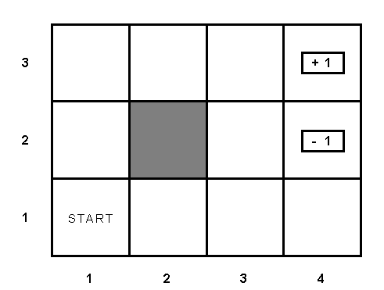
Example environment

Slide 12
Passive learning scenario
The agent see the the sequences of state transitions and associate rewards
The environment generates state transitions and the agent perceive them
e.g (1,1) →(1,2) →(1,3) →(2,3) →(3,3) →(4,3)[+1]
(1,1)→(1,2) →(1,3) →(1,2) →(1,3) →(1,2) →(1,1) →(2,1) →(3,1) →(4,1) →(4,2)[-1]
Key idea: updating the utility value using the given training sequences.

Slide 13
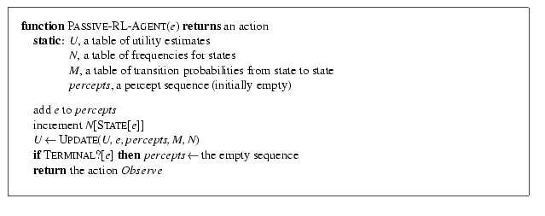
Passive leaning scenario

Slide 14
LMS updating
Reward to go of a state
the sum of the rewards from that state until a terminal state is reached
Key: use observed reward to go of the state as the direct evidence of the actual expected utility of that state
Learning utility function directly from sequence example

Slide 15
LMS updating
function LMS-UPDATE (U, e, percepts, M, N ) return an updated U
if TERMINAL?[e] then
{ reward-to-go ← 0
for each ei in percepts (starting from end) do
s = STATE[ei]
reward-to-go ← reward-to-go + REWARS[ei]
U[s] = RUNNING-AVERAGE (U[s], reward-to-go, N[s])
end
}
function RUNNING-AVERAGE (U[s], reward-to-go, N[s] )
U[s] = [ U[s] * (N[s] – 1) + reward-to-go ] / N[s]

Slide 16
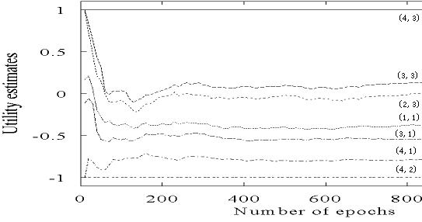
LMS updating algorithm in passive learning
Drawback:
The actual utility of a state is constrained to be probability- weighted average of its successor’s utilities.
Converge very slowly to correct utilities values (requires a lot of sequences)
for our example, >1000!

Slide 17
How to learn model?
Use the transition tuple <s, a, s’, r> to learn T(s,a,s’) and R(s,a). That’s supervised learning!
Since the agent can get every transition (s, a, s’,r) directly, so take (s,a)/s’ as an input/output example of the transition probability function T.
Different techniques in the supervised learning(see further reading for detail)
Use r and T(s,a,s’) to learn R(s,a)

Slide 18
ADP approach pros and cons
Pros:
ADP algorithm converges far faster than LMS and Temporal learning. That is because it use the information from the the model of the environment.
Cons:
Intractable for large state space
In each step, update U for all states
Improve this by prioritized-sweeping (see further reading for detail)

